Slide 1
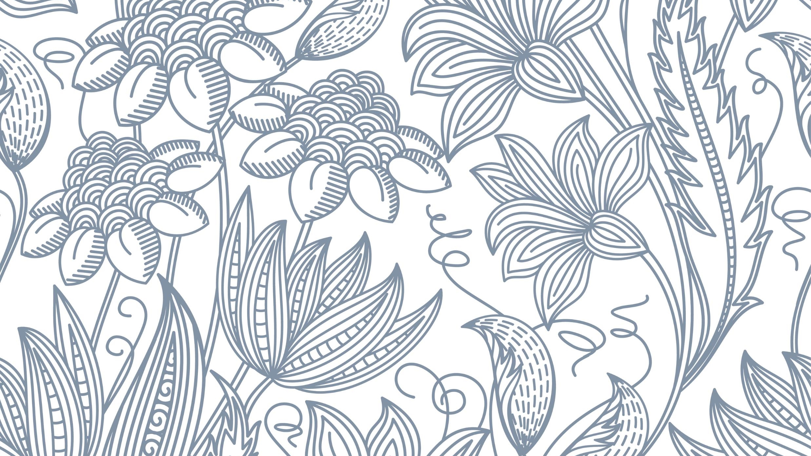
Horses Body Condition Score Chart
Whispering Oak Stables

Slide 2
A Horses or Ponies condition can be judged using the Body Condition Score from 1 to 9
This Horses Body condition would be scored a 9 because he is too fat!

Slide 3
Horse Body Condition Score 1=Starving horse with bones sticking out and no fat left, 5=the ideal body condition neither to fat or to thin, 9=an obese horse with fat filled in everywhere!

Slide 4
Horse Body Condition Score 1=Starving horse with bones sticking out and no fat left, 5=the ideal body condition neither to fat or to thin, 9=an obese horse with fat filled in everywhere!
How would you score this horse?
How would you score this horse?

Slide 5
Horse Body Condition
1=Starving horse with bones sticking out and no fat left, 5=the ideal body condition neither to fat or to thin, 9=an obese horse with fat filled in everywhere!
How would you score this horse?
How would you score this horse?

Slide 6
Horse Body Condition Score
1=Starving horse with bones sticking out and no fat left, 5=the ideal body condition neither to fat or to thin, 9=an obese horse with fat filled in everywhere!
How would you score this horse?
How would you score this horse?

